Slide 1
Dimensionality Reduction
Lei Qian, Ph.D.

Slide 2
Dimensionality Reduction
Dimensionality reduction is the process of converting a data set with vast dimension to lesser dimensions while the latter loses little information.
Why dimensionality reduction?
Faster training.
Reducing memory requirement.
Reducing the storage space required.
Taking care of multi-collinearity that improves the model performance.
Improving the quality of results by removing noises.
Reducing high dimensional data to 2D or 3D for visualization.

Slide 3
Techniques of Dimensionality Reduction
Missing Values: if a feature misses too many values, dropping the variable may be a better choice than imputing data.
Low variance variable. In extreme case, zero variance data. These kinds of variables carry little or no information.
PCA, LDA and similar algorithms
Decision tree, random forest etc.
Factor analysis.

Slide 4
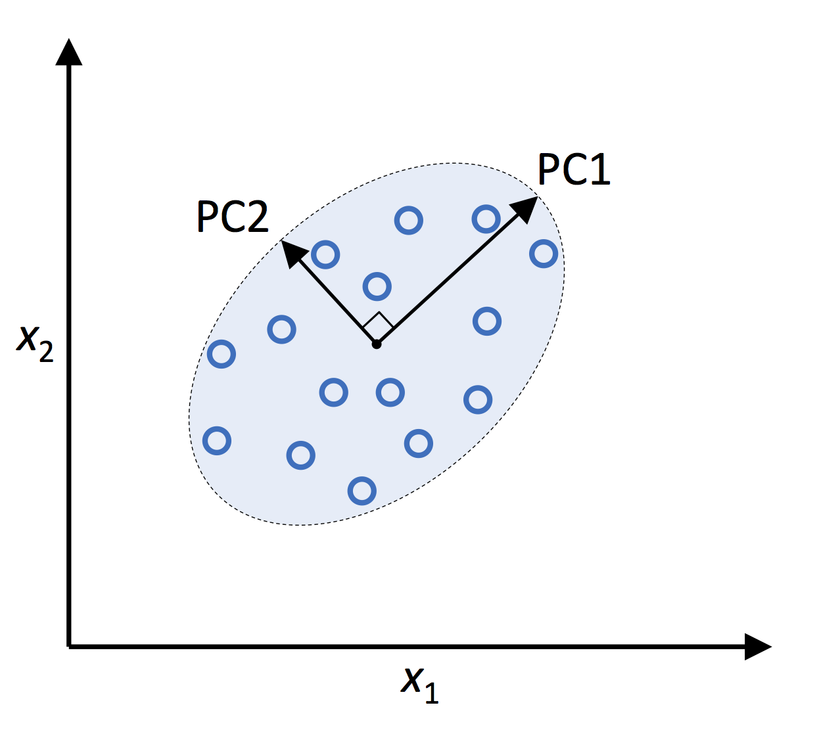
Principal Component Analysis (PCA)
PC1: the vector with the largest variance.
PC2: the vector orthogonal to PC1 with the largest variance.
PC3, PC4, … can be defined similarly.
Assume we have n features, we can compute
PC1, …, PCn. To use PCA for dimensionality reduction,
we can just keep the first k principal components and
omit rest of them.

Slide 5
Principal Component Analysis (PCA)
Steps of PCA:
1. Standardize the d-dimensional dataset.
2. Construct the covariance matrix.
3. Calculate eigenvectors and eigenvalues of the covariance matrix.
4. Sort absolute values of eigenvalues by decreasing order to rank the corresponding eigenvectors.
5. Select k eigenvectors which correspond to the k largest eigenvalues.
6. Construct a projection matrix W from the "top" k eigenvectors.
7. Transform the d-dimensional input dataset X using the projection matrix W
to obtain the new k-dimensional feature subspace.

Slide 6
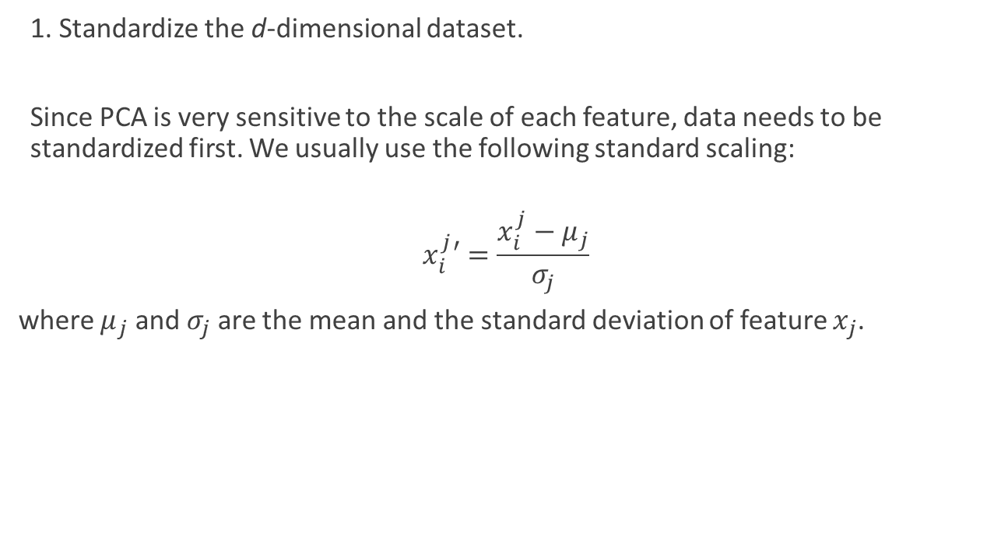
Principal Component Analysis (PCA)
1. Standardize the d-dimensional dataset.
Since PCA is very sensitive to the scale of each feature, data needs to be standardized first. We usually use the following standard scaling:
$$x_{i}^{j}′=\frac{x_{i}^{j}−μ_{j}}{σ_{j}}$$
where $μ_{j}$ and $σ_{j}$ are the mean and the standard deviation of feature $x_{j}$.

Slide 7
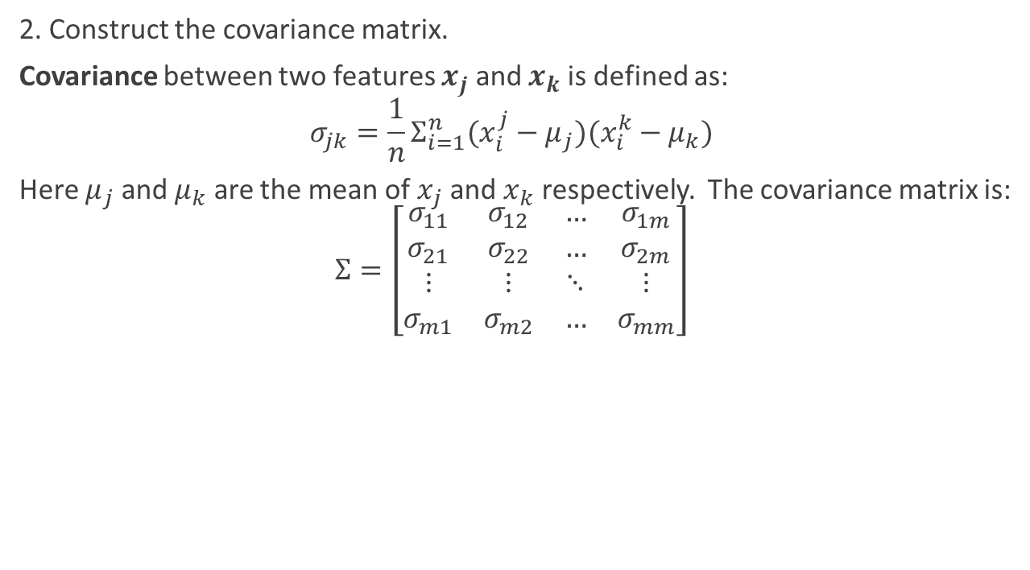
Principal Component Analysis (PCA)
2. Construct the covariance matrix.
Covariance between two features $x_{j}$ and $x_{k}$ is defined as:
$$σ_{jk}=\frac{1}{n}Σ_{i=1}^{n}(x_{i}^{j}−μ_{j})(x_{i}^{k}−μ_{k})$$
Here $μ_{j}$ and $μ_{k}$ are the mean of $x_{j}$ and $x_{k}$ respectively. The covariance matrix is:
$$Σ=\left[\begin{matrix}σ_{11} & σ_{12} & … & σ_{1m} \\ σ_{21} & σ_{22} & … & σ_{2m} \\ ⋮ & ⋮ & ⋱ & ⋮ \\ σ_{m1} & σ_{m2} & … & σ_{mm}\end{matrix}\right]$$

Slide 8
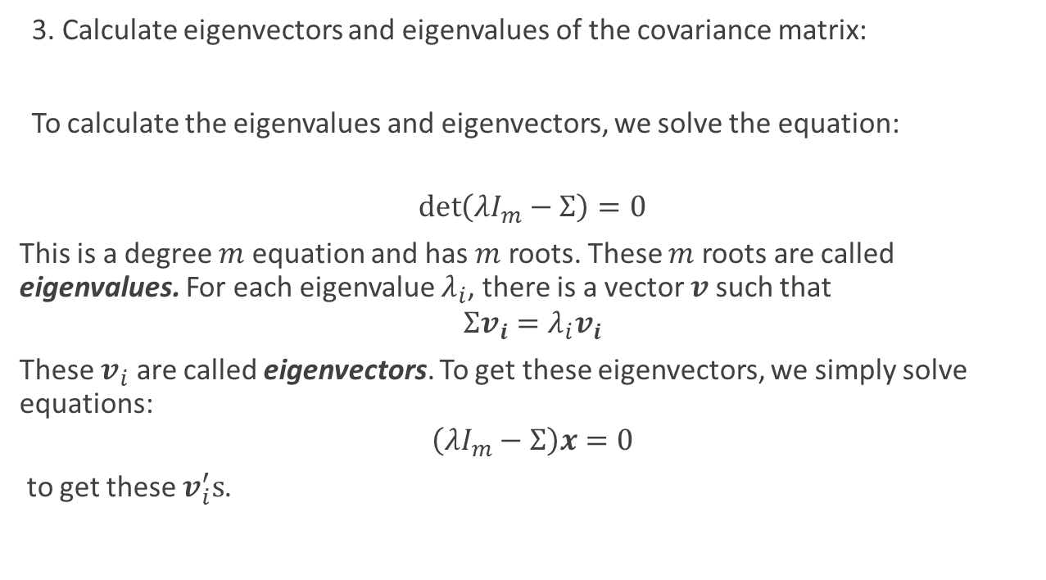
Principal Component Analysis (PCA)
3. Calculate eigenvectors and eigenvalues of the covariance matrix:
To calculate the eigenvalues and eigenvectors, we solve the equation:
$$\det\left(λI_{m}−Σ\right)=0$$
This is a degree $m$ equation and has $m$ roots. These $m$ roots are called eigenvalues. For each eigenvalue $λ_{i}$, there is a vector $v$ such that
$$Σv_{i}=λ_{i}v_{i}$$
These $v_{i}$ are called eigenvectors. To get these eigenvectors, we simply solve equations:
$$\left(λI_{m}−Σ\right)x=0$$
to get these $v_{i}^{′}s$.

Slide 9
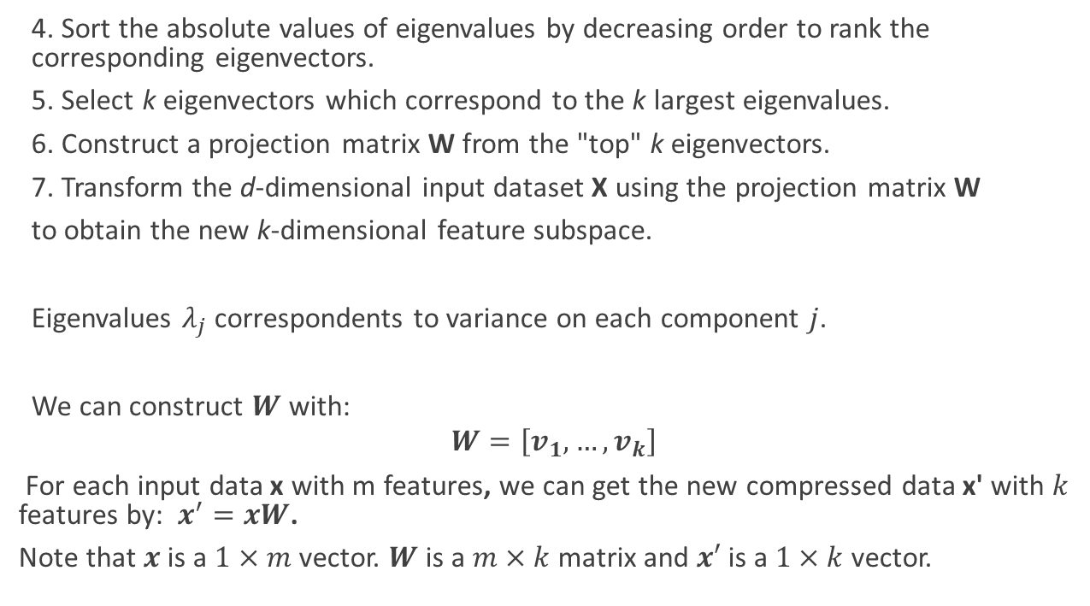
Principal Component Analysis (PCA)
4. Sort the absolute values of eigenvalues by decreasing order to rank the corresponding eigenvectors.
5. Select k eigenvectors which correspond to the k largest eigenvalues.
6. Construct a projection matrix W from the "top" k eigenvectors.
7. Transform the d-dimensional input dataset X using the projection matrix W
to obtain the new k-dimensional feature subspace.
Eigenvalues $λ_{j}$ correspondents to variance on each component $j$.
We can construct $W$ with:
$$W=\left[v_{1},…,v_{k}\right]$$
For each input data x with m features, we can get the new compressed data x' with $k$ features by: $x^{′}=xW$.
Note that $x$ is a $1×m$ vector. $W$ is a $m×k$ matrix and $x′$ is a $1×k$ vector.

Slide 10
PCA with Scikit-learn
Build a PCA object:
pca = PCA(n_component = k)
Compute PCA:
pca.fit(X)
Transform by PCA:
pca.transform(X)
Combine fit and transform:
pca.fit_transform(X)

Slide 11
Linear Discrimination Analysis (LDA)
PCA is an unsupervised data compression (dimensionality reduction) method.
Linear Discrimination Analysis (LDA) aims to reducing dimensionality for maximizing class separability. It is a supervised dimensionality reduction method.
LDA can be used as a technique for feature extraction to increase the computational efficiency and reduce the degree of overfitting due to the curse of dimensionality in non-regularized models.
While PCA attempts to find the orthogonal component axes of maximum variance, LDA is to find the feature subspace that optimizes class separability.
LDA is sometimes also called Fisher's LDA. Ronald A. Fisher initially formulated Fisher's Linear Discriminant for two-class classification problems in 1936

Slide 12
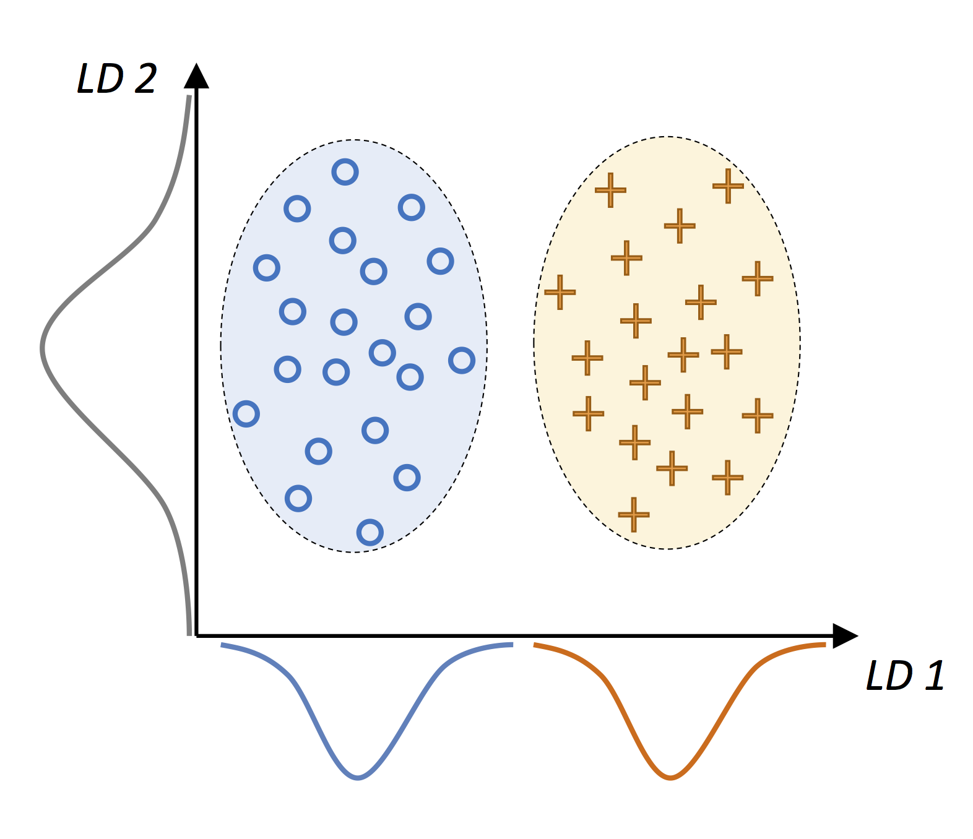
Linear Discrimination Analysis (LDA)
Consider this distribution :
A linear discriminant, as shown on the x-axis (LD 1), would separate the two normal distributed classes well. Although the exemplary linear discriminant shown on the y-axis (LD 2) captures a lot of the variance in the dataset, it would fail as a good linear discriminant since it does not capture any of the class-discriminatory information.

Slide 13
Linear Discrimination Analysis (LDA)
LDA assume that:
the classes have identical covariance matrices
samples are statistically independent of each other
In practice, these two conditions may not be totally true. But LDA still works if they are slightly violated.

Slide 14

Linear Discrimination Analysis (LDA)
Steps of LDA:
1. Standardize the d-dimensional dataset (d is the number of features).
2. For each class, compute the d-dimensional mean vector and construct the between-class scatter matrix $S_{B}$ and the within-class scatter matrix $S_{w}$.
3. Compute the eigenvectors and corresponding eigenvalues of the matrix $S_{W}^{−1}S_{B}$.
4. Sort the eigenvalues by decreasing order to rank the corresponding eigenvectors.
5. Choose the k eigenvalues with largest absolute values.
6. Choose the k eigenvectors that correspond to eigenvalues selected in step 5. Construct a $d×k$-dimensional transformation matrix W; the eigenvectors are the columns of this matrix.
7. Project the samples onto the new feature subspace using the transformation matrix W.
Same as PCA

Slide 15
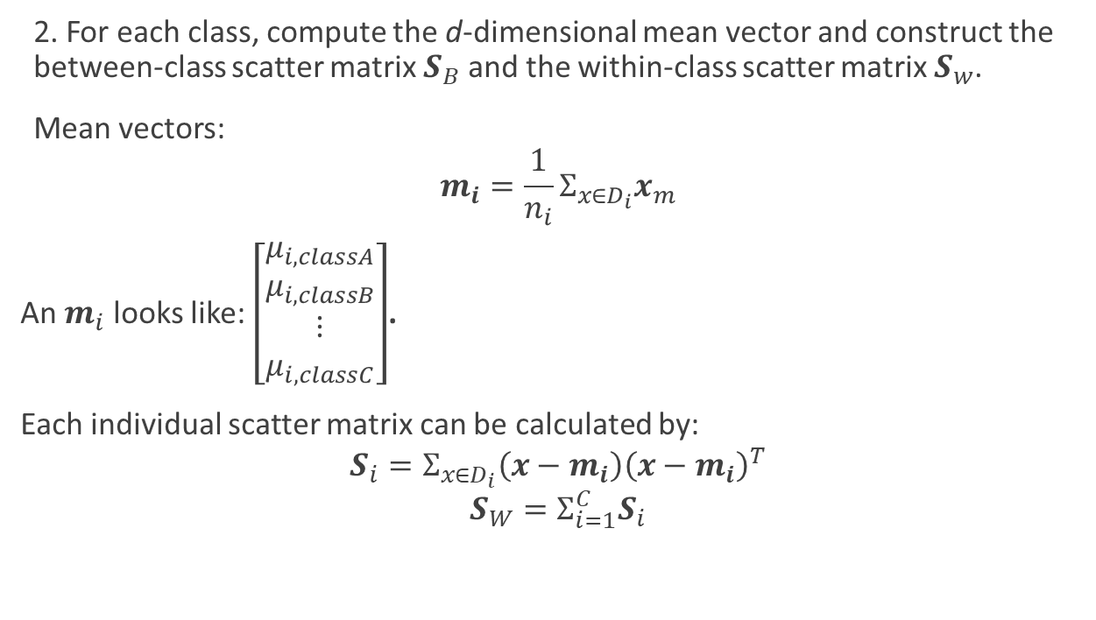
Linear Discrimination Analysis (LDA)
2. For each class, compute the d-dimensional mean vector and construct the between-class scatter matrix $S_{B}$ and the within-class scatter matrix $S_{w}$.
Mean vectors:
$$m_{i}=\frac{1}{n_{i}}Σ_{x∈D_{i}}x_{m}$$
An $m_{i}$ looks like: $\left[\begin{matrix}μ_{i, classA} \\ μ_{i,classB} \\ ⋮ \\ μ_{i,classC}\end{matrix}\right]$.
Each individual scatter matrix can be calculated by:
$$S_{i}=Σ_{x∈D_{i}}\left(x−m_{i}\right){\left(x−m_{i}\right)}^{T}$$
$$S_{W}=Σ_{i=1}^{C}S_{i}$$

Slide 16

Linear Discrimination Analysis (LDA)
2. For each class, compute the d-dimensional mean vector and construct the between-class scatter matrix $S_{B}$ and the within-class scatter matrix $S_{w}$.
Between class scatter matrix can be computed by:
$$S_{B}=Σ_{i=1}^{c}n_{i}\left(m_{i}−m\right){\left(m_{i}−m\right)}^{T}$$
Here $m$ is the overall mean that is computed from all samples from all classes.

Slide 17
LDA with Scikit-learn
from sklearn.discriminant_analysis import LinearDiscriminantAnalysis as LDA
Build a LDA object:
lda = LDA(n_component = k)
Compute LDA:
lda.fit(X, y)
Transform by LDA:
lda.transform(X)
Combine fit and transform:
lda.fit_transform(X,y)

Slide 18
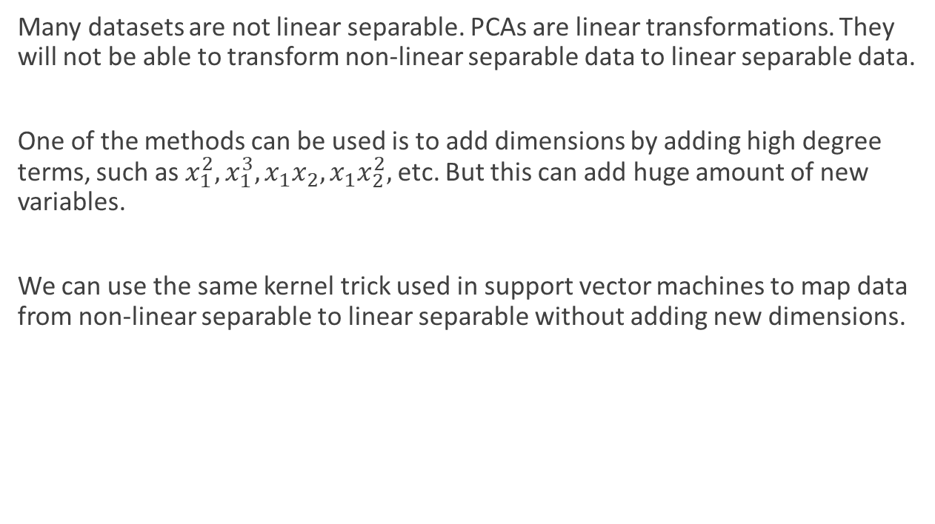
Kernel PCA
Many datasets are not linear separable. PCAs are linear transformations. They will not be able to transform non-linear separable data to linear separable data.
One of the methods can be used is to add dimensions by adding high degree terms, such as $x_{1}^{2},x_{1}^{3},x_{1}x_{2}, x_{1}x_{2}^{2},$ etc. But this can add huge amount of new variables.
We can use the same kernel trick used in support vector machines to map data from non-linear separable to linear separable without adding new dimensions.

Slide 19
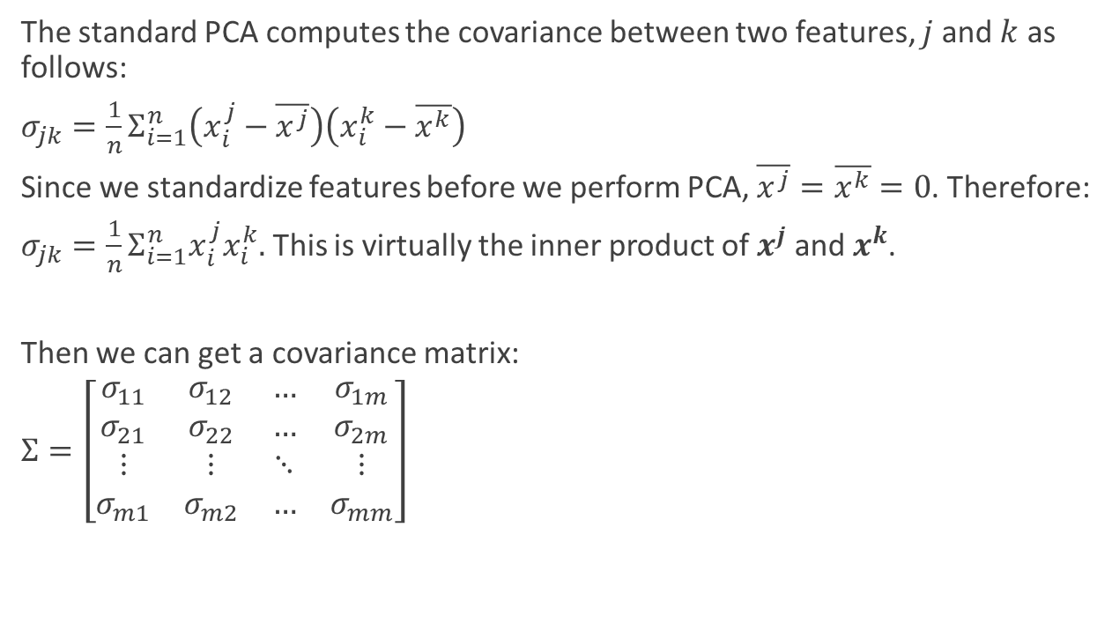
Kernel PCA
The standard PCA computes the covariance between two features, $j$ and $k$ as follows:
$σ_{jk}=\frac{1}{n}Σ_{i=1}^{n}\left(x_{i}^{j}−\overline{x^{j}}\right)\left(x_{i}^{k}−\overline{x^{k}}\right)$
Since we standardize features before we perform PCA, $\overline{x^{j}}=\overline{x^{k}}=0$. Therefore:
$σ_{jk}=\frac{1}{n}Σ_{i=1}^{n}x_{i}^{j}x_{i}^{k}.$ This is virtually the inner product of $x^{j}$ and $x^{k}$.
Then we can get a covariance matrix:
$Σ=\left[\begin{matrix}σ_{11} & σ_{12} & … & σ_{1m} \\ σ_{21} & σ_{22} & … & σ_{2m} \\ ⋮ & ⋮ & ⋱ & ⋮ \\ σ_{m1} & σ_{m2} & … & σ_{mm}\end{matrix}\right]$

Slide 20
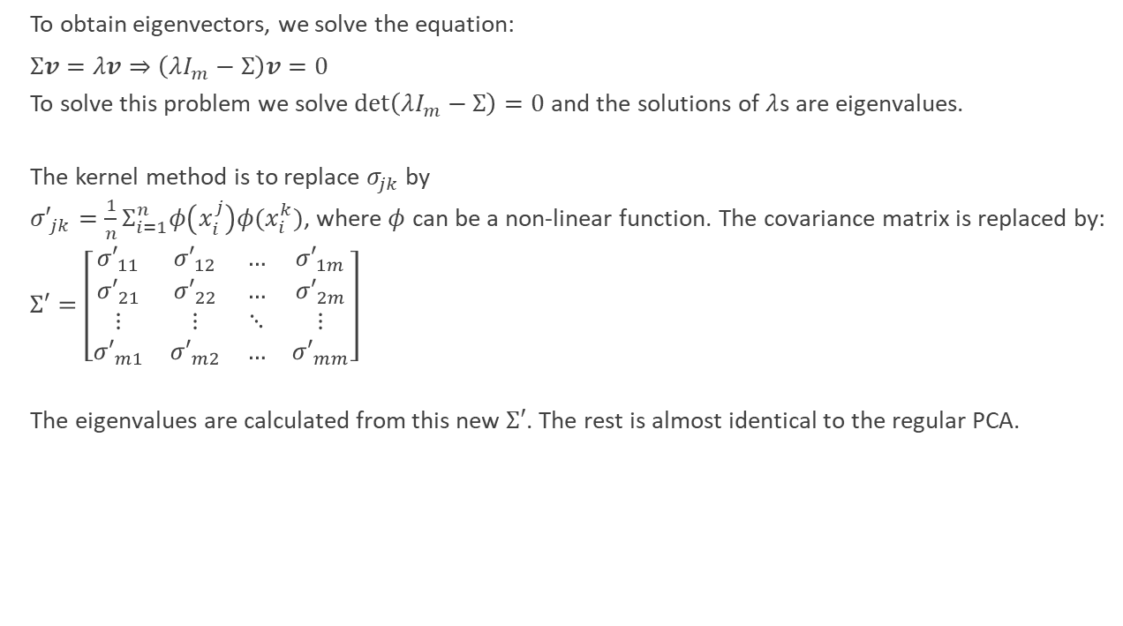
Kernel PCA
To obtain eigenvectors, we solve the equation:
$Σv=λv⇒\left(λI_{m}−Σ\right)v=0$
To solve this problem we solve $\det\left(λI_{m}−Σ\right)=0$ and the solutions of $λ$s are eigenvalues.
The kernel method is to replace $σ_{jk}$ by
${σ′}_{jk}=\frac{1}{n}Σ_{i=1}^{n}φ\left(x_{i}^{j}\right)φ(x_{i}^{k})$, where $φ$ can be a non-linear function. The covariance matrix is replaced by:
$Σ′=\left[\begin{matrix}{σ′}_{11} & {σ′}_{12} & … & {σ′}_{1m} \\ {σ′}_{21} & {σ′}_{22} & … & {σ′}_{2m} \\ ⋮ & ⋮ & ⋱ & ⋮ \\ {σ′}_{m1} & {σ′}_{m2} & … & {σ′}_{mm}\end{matrix}\right]$
The eigenvalues are calculated from this new $Σ′$. The rest is almost identical to the regular PCA.

Slide 21
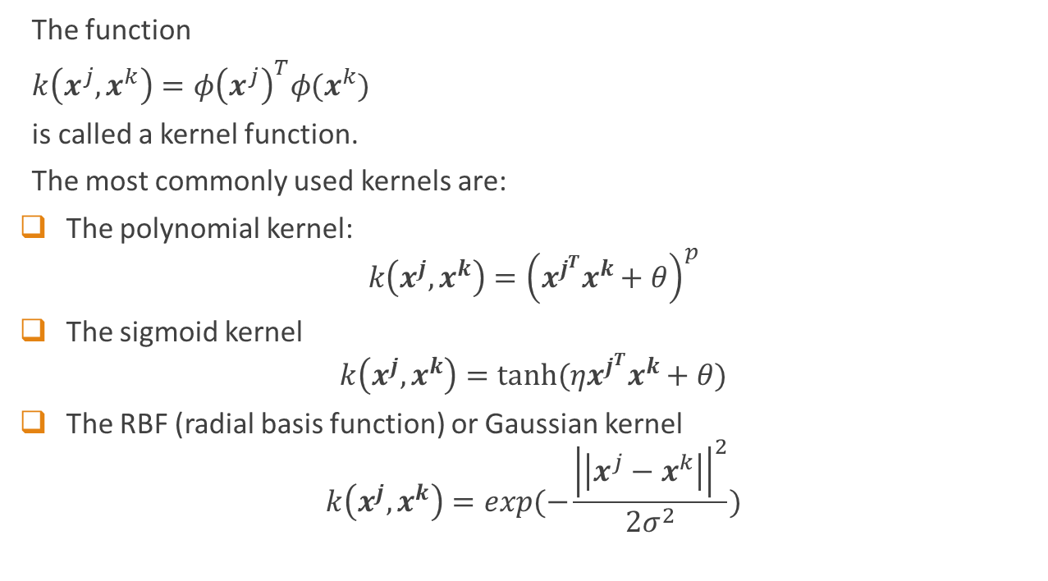
Kernel PCA
The function
$k\left(x^{j},x^{k}\right)=φ{\left(x^{j}\right)}^{T}φ(x^{k})$
is called a kernel function.
The most commonly used kernels are:
The polynomial kernel:
$$k\left(x^{j},x^{k}\right)={\left(x^{j^{T}}x^{k}+θ\right)}^{p}$$
The sigmoid kernel
$$k\left(x^{j},x^{k}\right)=tanh(ηx^{j^{T}}x^{k}+θ)$$
The RBF (radial basis function) or Gaussian kernel
$$k\left(x^{j},x^{k}\right)=exp(−\frac{{\left|\left|x^{j}−x^{k}\right|\right|}^{2}}{2σ^{2}})$$

